Slide 1
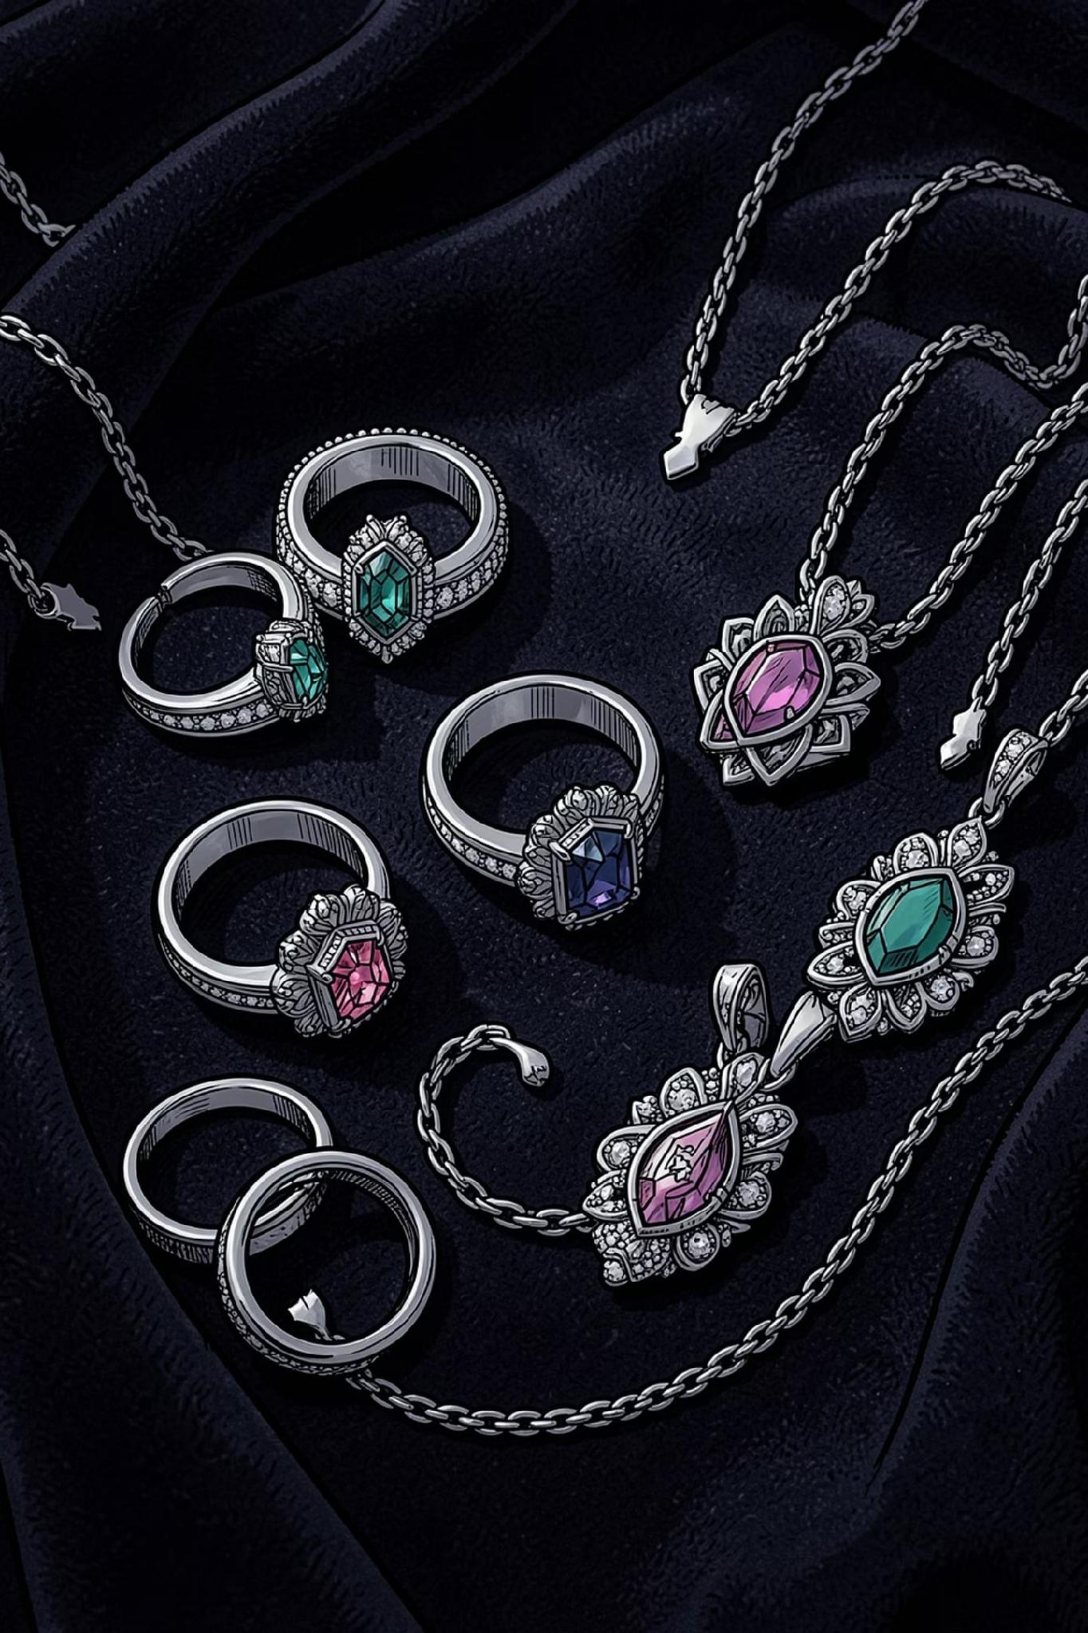
Silver Jewellery Report
A comprehensive market intelligence report covering India's silver jewellery landscape — consumer trends, pricing dynamics, and growth opportunities for retailers, wholesalers, and investors.
MARKET INTELLIGENCE
INDIA · 2026

Slide 2
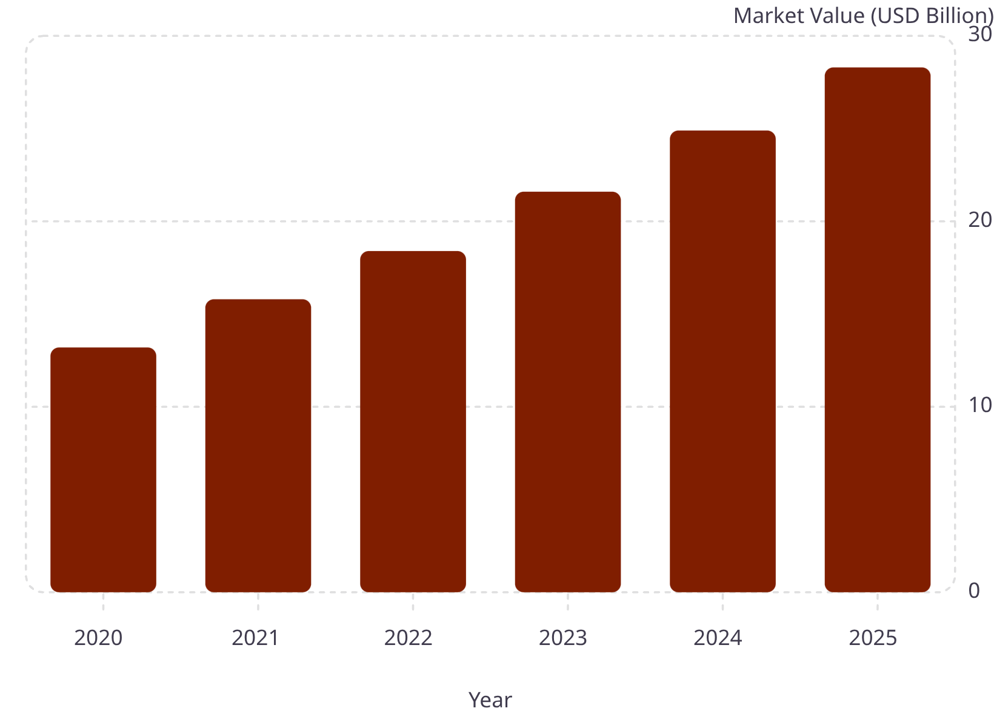
India's Silver Jewellery Market — Size & Growth
Market Overview
India's silver jewellery market has grown steadily, driven by rising disposable incomes, festive demand, and a cultural affinity for silver. The market is projected to surpass USD 28 billion by 2025, reflecting a CAGR of approximately 16% since 2020.
Strong Tier-2 and Tier-3 city penetration
Growing preference for lightweight, contemporary designs
Export demand supplementing domestic consumption

Slide 3
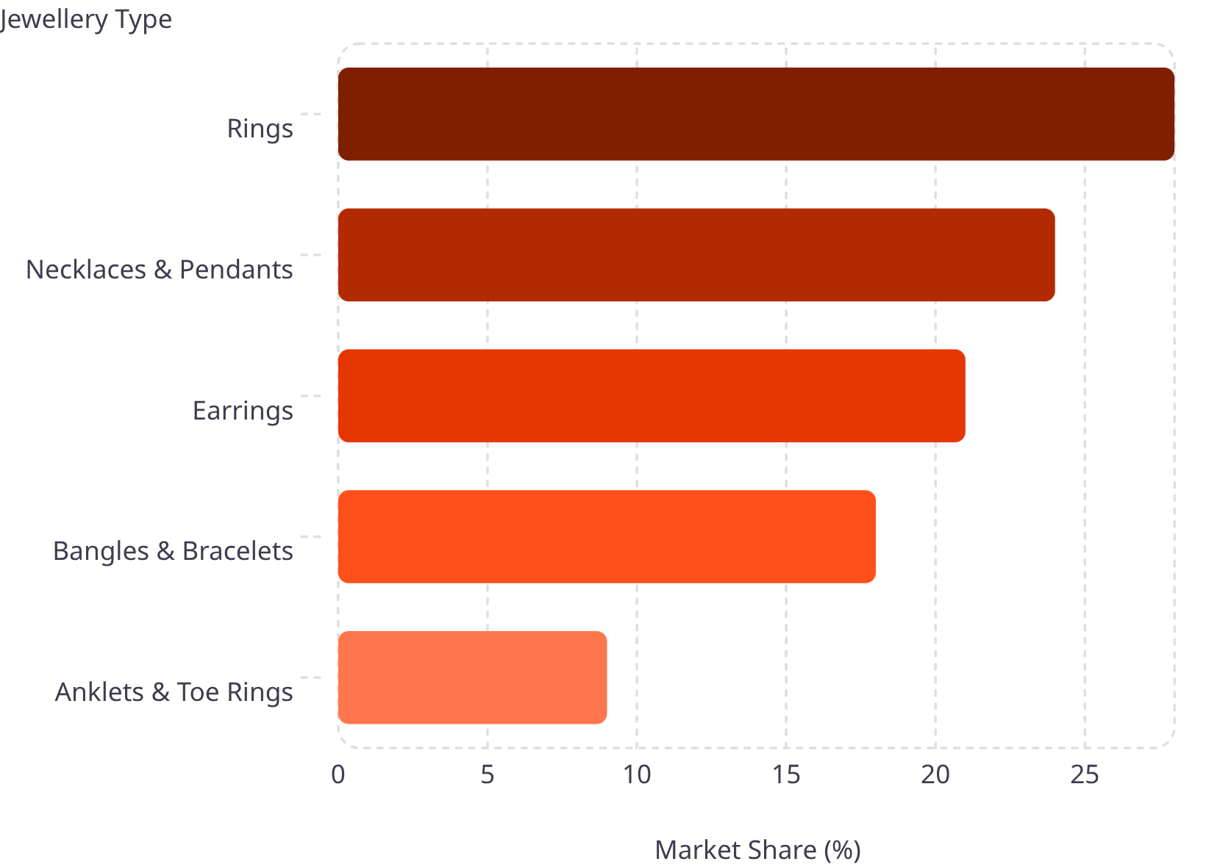

Consumer Preference by Jewellery Type
What Drives Preference
Rings lead consumer preference at 28%, followed closely by necklaces and pendants. Earrings and bangles remain strong categories, particularly in traditional markets across South and West India.
Anklets and toe rings, while niche, show strong regional demand in rural and semi-urban markets, representing an underserved opportunity for specialised retailers.

Slide 4
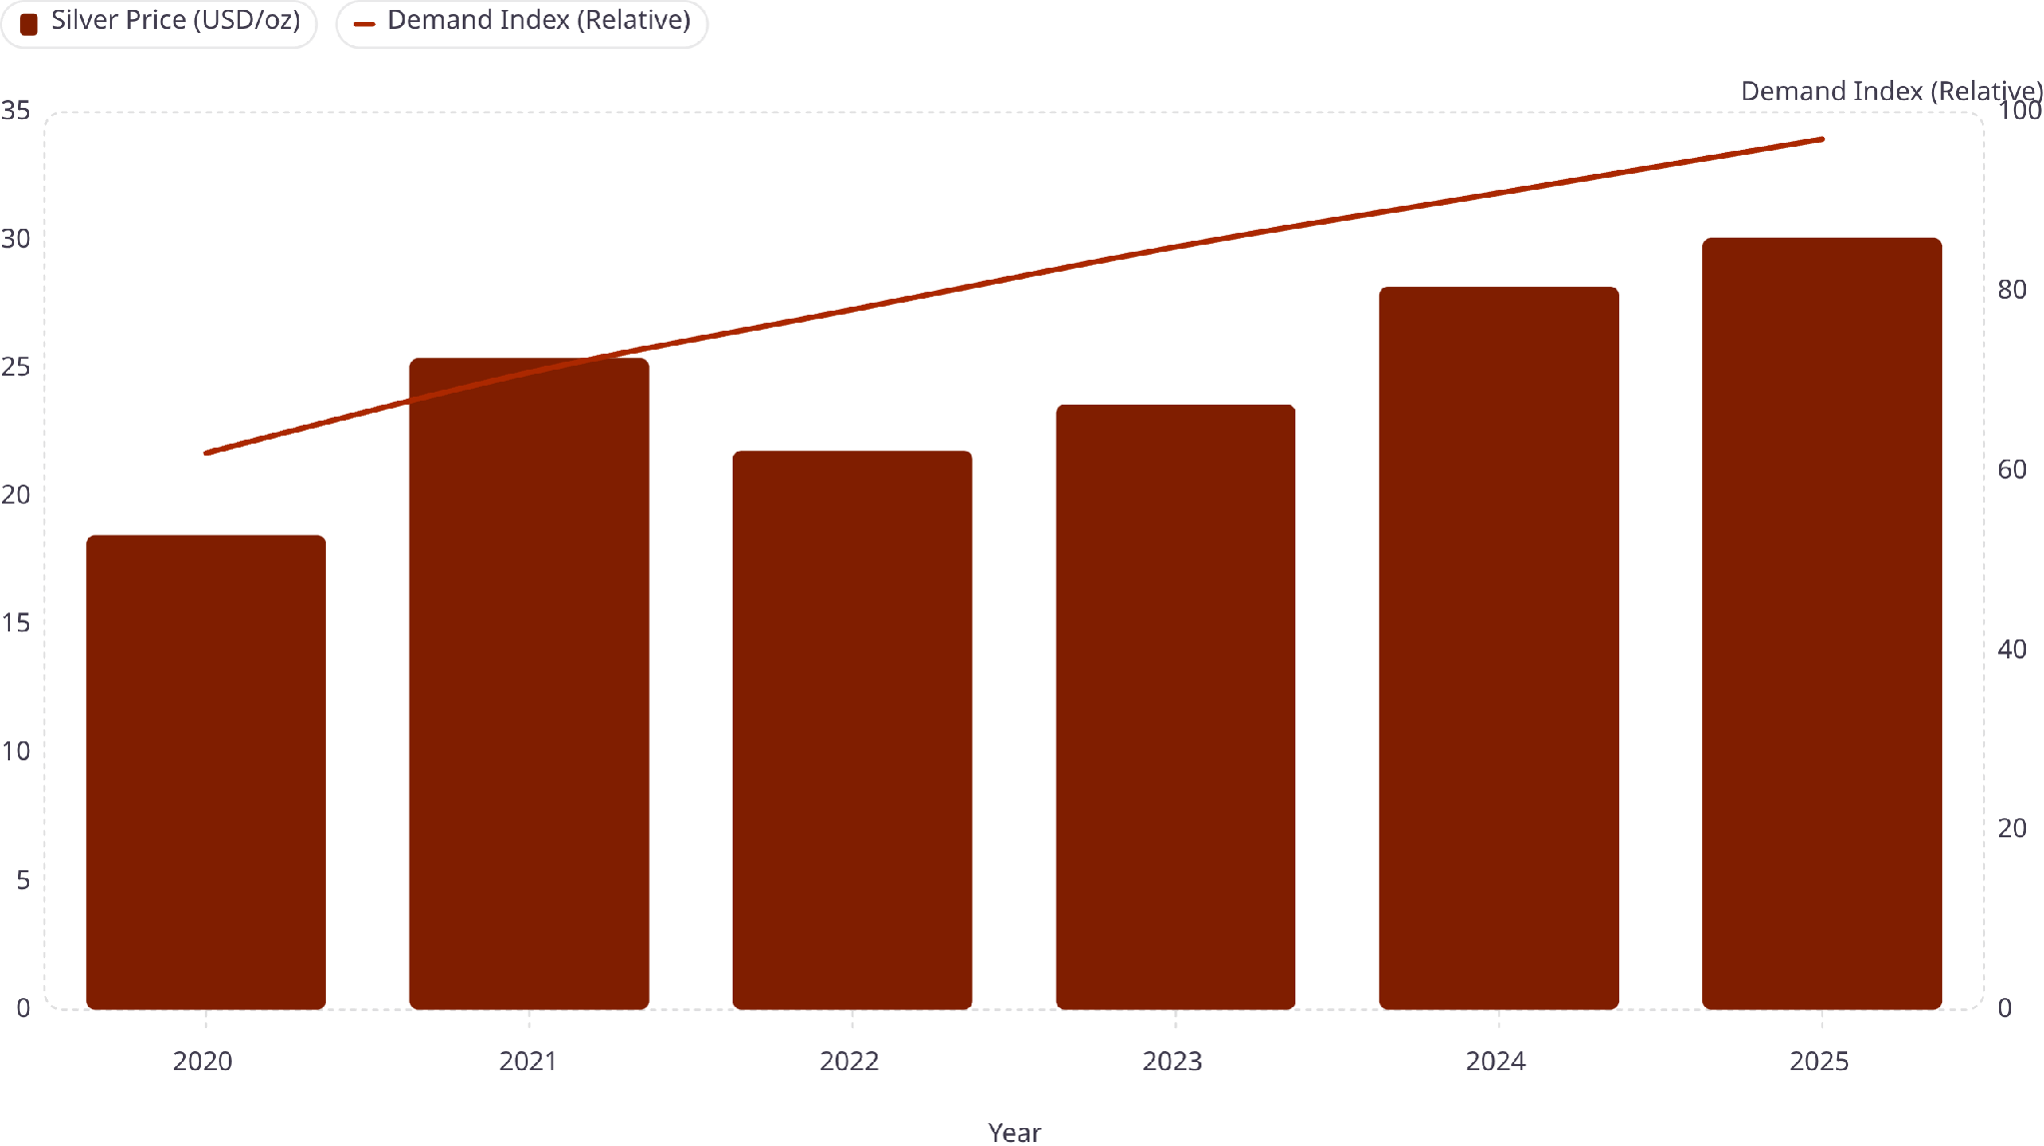
Silver Price Trend vs. Jewellery Demand (2020–2025)
Despite rising silver prices, consumer demand has continued to climb — indicating strong underlying market fundamentals. The Demand Index has grown 56% since 2020, even as prices rose over 60%, suggesting that price sensitivity is offset by cultural and investment-driven purchasing behaviour.

Slide 5
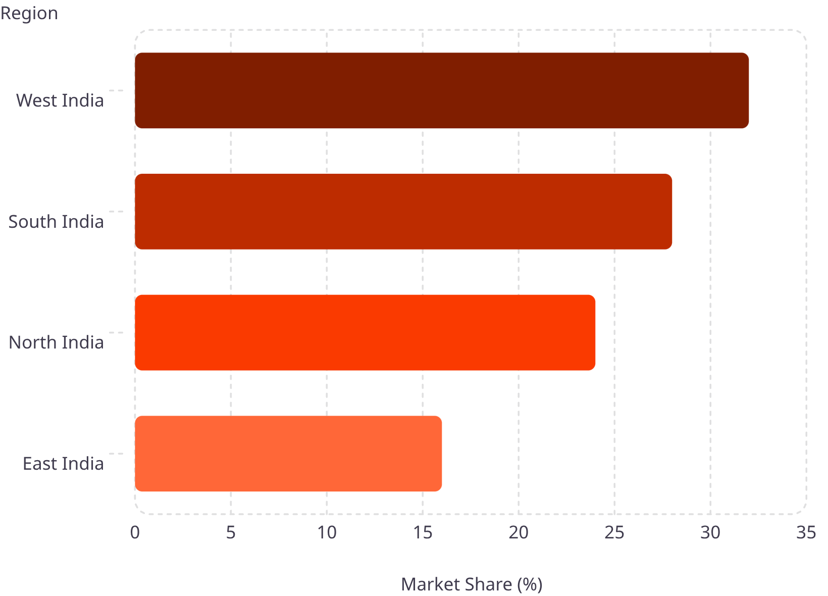
Regional Market Share — Silver Jewellery Sales
Regional Insights
West India (Maharashtra, Gujarat, Rajasthan) dominates with 32% of national sales, driven by wedding season demand and a strong tradition of silver gifting. South India follows closely, with Karnataka and Tamil Nadu showing robust urban growth.
West & South India: 60% of total market volume
North India: Growing urban middle-class demand
East India: Emerging opportunity with untapped potential

Slide 6
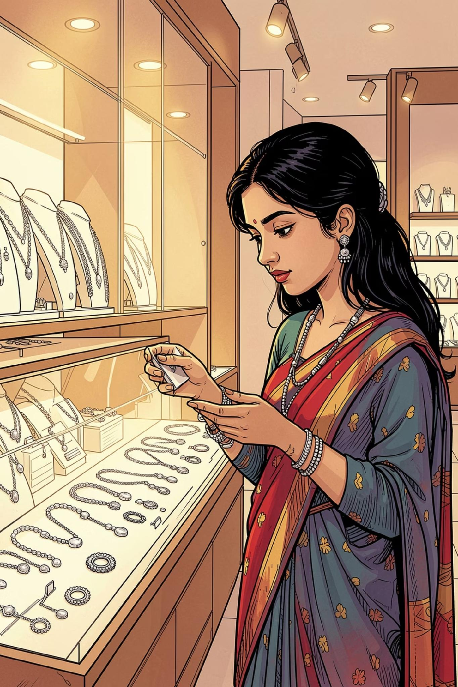
Consumer Demographics — Who Is Buying?
Age 18–30
Age 31–45
34% of buyers — driven by fashion-forward, lightweight designs and online purchasing
41% of buyers — highest spenders; prefer traditional designs and investment-grade pieces
Age 46+
25% of buyers — value purity, brand trust, and heirloom-quality craftsmanship
The 31–45 age group represents the core revenue segment, while the 18–30 cohort is the fastest-growing — presenting a dual opportunity for retailers to balance traditional and contemporary product lines.

Slide 7
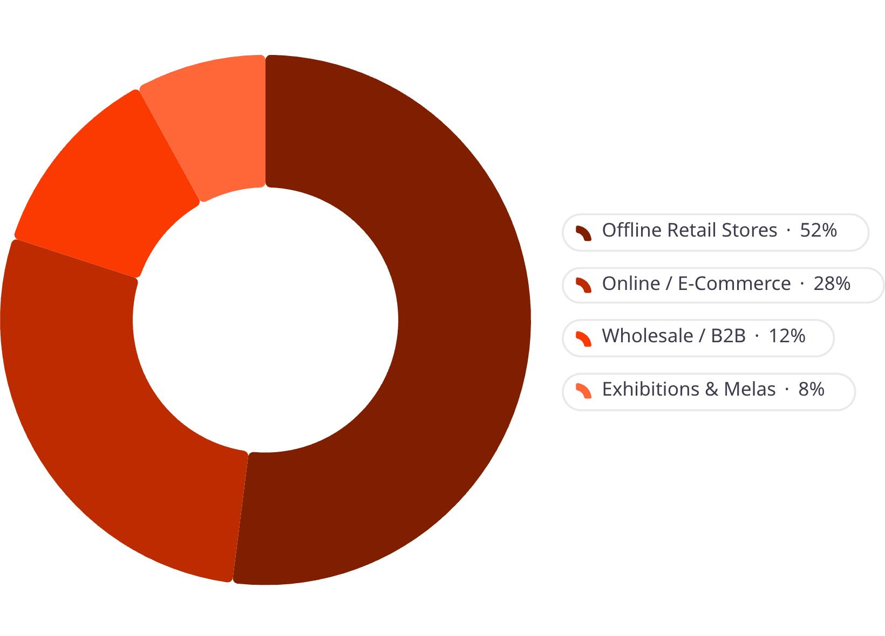

Sales Channel Distribution
Channel Shift in Progress
Offline retail still commands over half of all sales, but e-commerce is rapidly gaining ground — particularly among urban millennials. Online channels grew from 15% in 2020 to 28% in 2025.
Wholesale and B2B channels remain critical for regional distributors and smaller retailers sourcing inventory from manufacturing hubs like Jaipur and Kolkata.

Slide 8
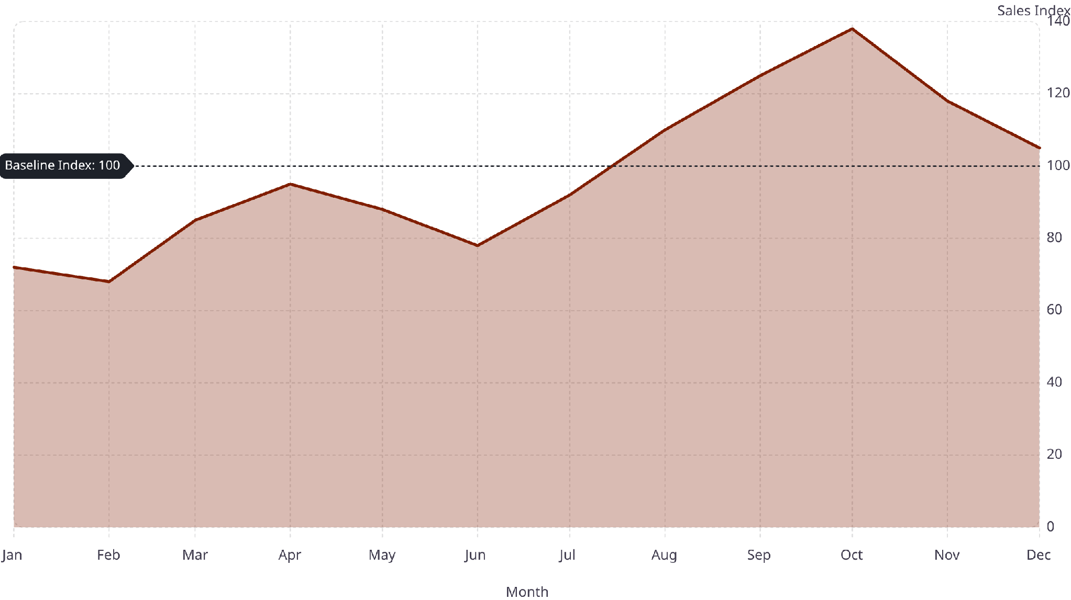
Seasonal Demand Pattern — Monthly Sales Index
The festive window from August to November (Raksha Bandhan, Janmashtami, Navratri, Diwali) accounts for nearly 45% of annual sales volume. Retailers should plan inventory and marketing campaigns at least 60–90 days ahead of this peak season to maximise revenue.

Slide 9
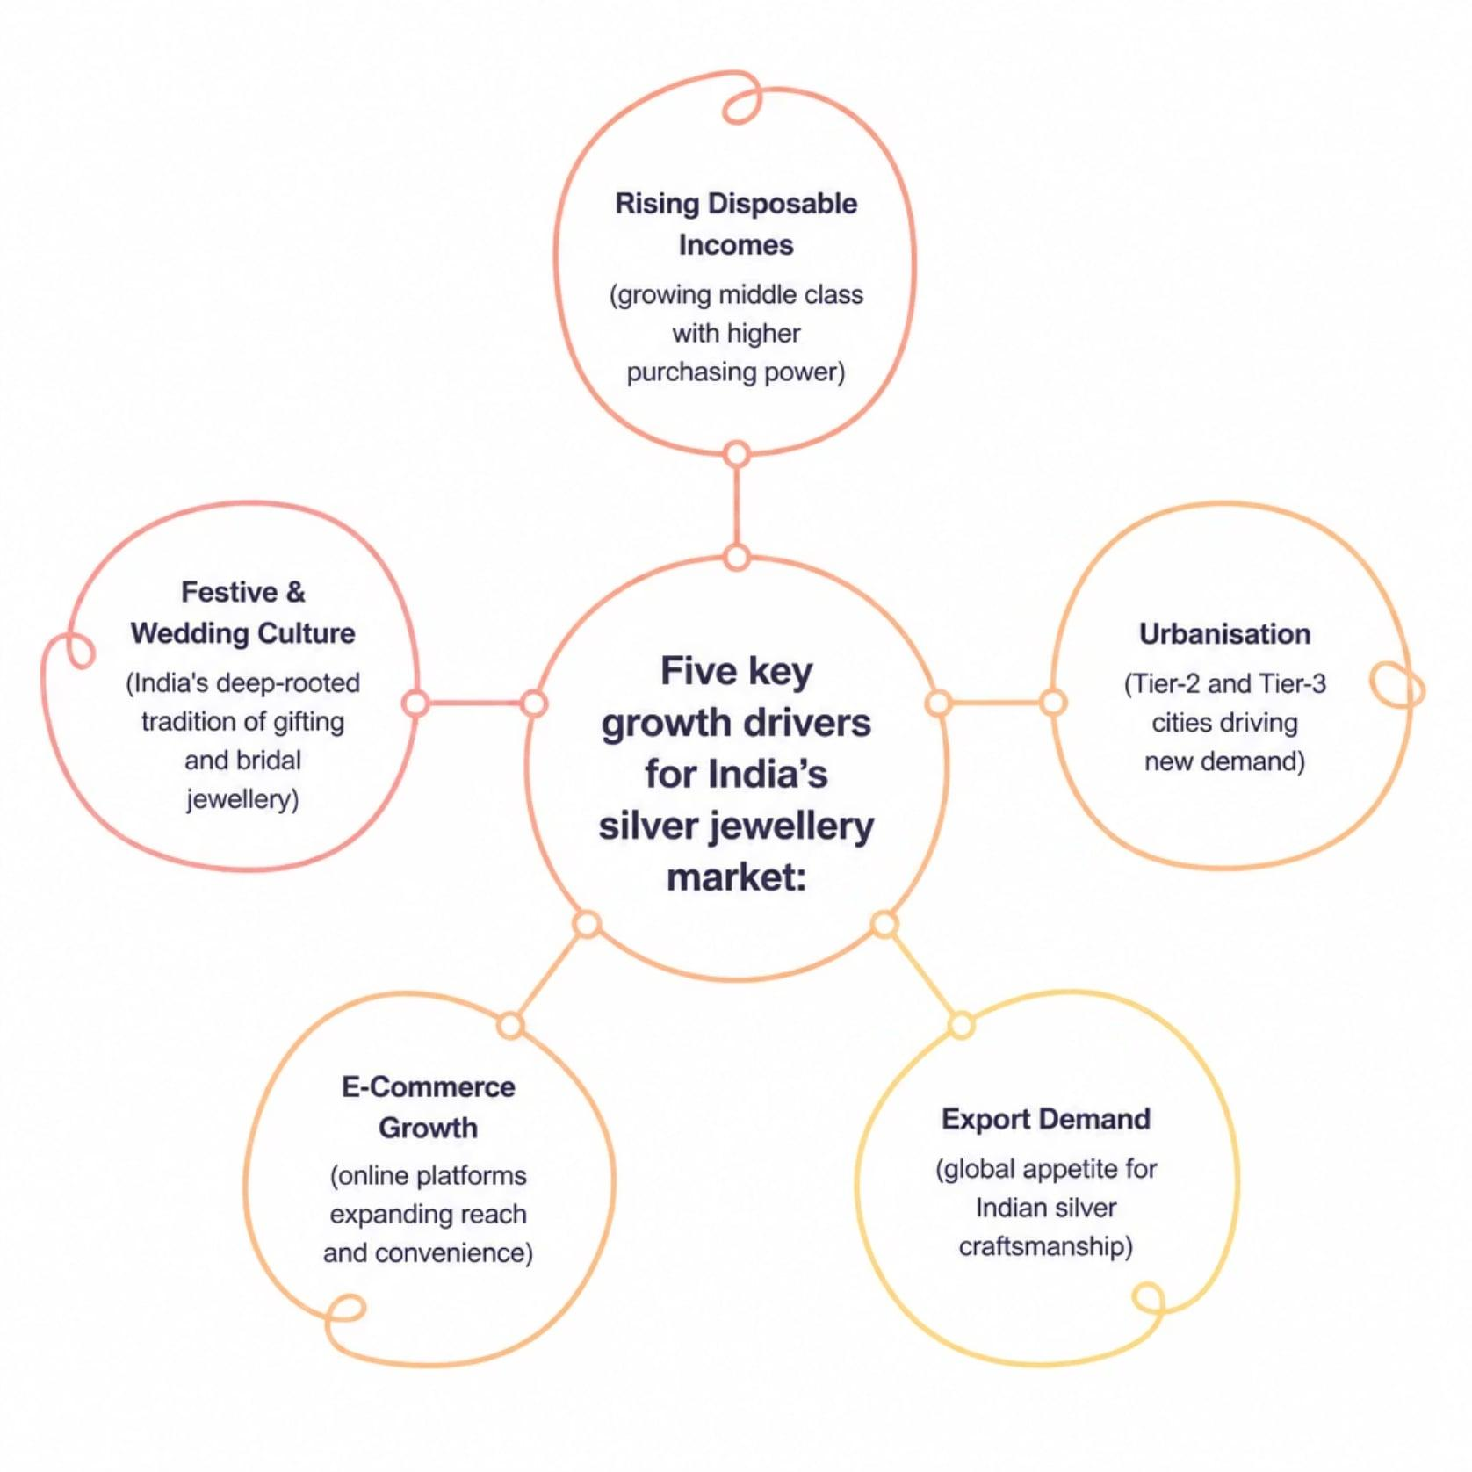
Key Market Drivers & Growth Catalysts
Why the Market Is Accelerating
India's silver jewellery sector benefits from a rare combination of cultural tailwinds and economic momentum. Rising incomes, urbanisation, and digital commerce are expanding the addressable market beyond traditional strongholds.
Wedding and gifting culture ensures consistent baseline demand
Export orders from US, UK, and Middle East supplement domestic sales
Government's PLI scheme supporting domestic manufacturing

Slide 10
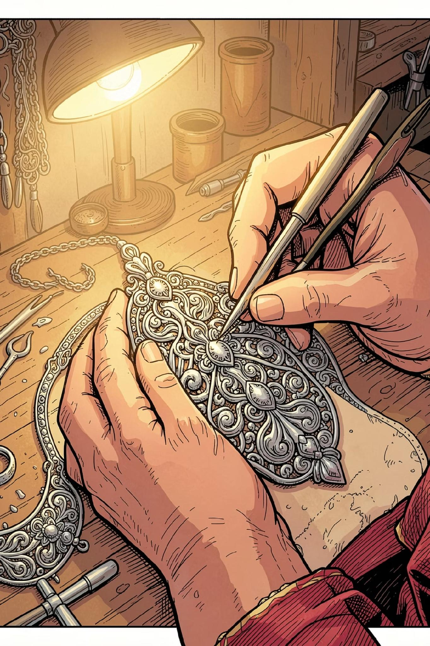
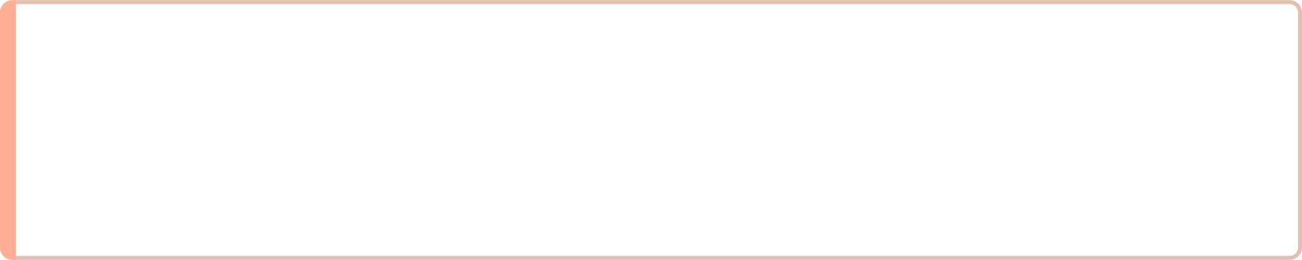
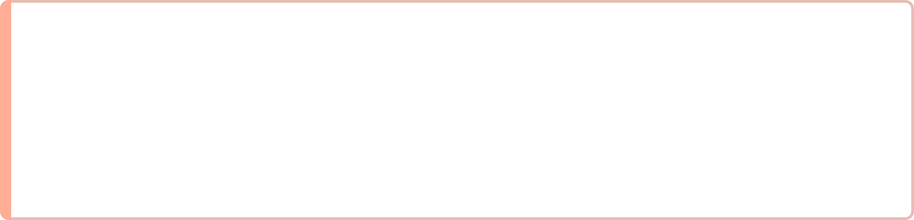
Strategic Outlook & Recommendations
For Retailers
Expand festive-season inventory by Q2; invest in omnichannel presence to capture the growing online segment.
For Wholesalers
Strengthen ties with Tier-2 city retailers; diversify product mix toward lightweight, contemporary designs for younger buyers.
For Investors
The sector's 16% CAGR and resilient demand fundamentals make silver jewellery a compelling mid-term investment thesis in India's consumer goods space.

